Slide 1


Department of Computer Science
University Institute of Engineering
DEPARTMENT OF COMPUTER SCIENCE & ENGINEERING
Bachelor of Engineering
Subject Name: System Programming
Subject Code: CST-315
Compilers
DISCOVER . LEARN . EMPOWER

Slide 2
Chapter-3.1 Linkers and Loaders
Department of computer Science
Loaders
Different Loading Schemes
- Compile-and-Go Loaders
- General Loader Schemes
- Absolute Loaders

Slide 3
Loaders .
Loader: Loader is utility program which is responsible for the activities such as allocation, linking, relocation and loading.
1) It allocates the space for program in the memory, by calculating the size of the
program. This activity is called allocation.
2) It resolves the symbolic references (code/data) between the object modules by
assigning all the user subroutine and library subroutine addresses. This activity is
called linking.
3) There are some address dependent locations in the program, such address
constants must be adjusted according to allocated space, such activity done by
loader is called relocation.
4) Finally it places all the machine instructions and data of corresponding programs
and subroutines into the memory. Thus program now becomes ready for
execution, this activity is called loading.

Slide 4
Loader Schemes
Based on the various functionalities of loader, there are various types of loaders:
Compile and go loader:
In this type of loader, the instruction is read line by line, its machine code is obtained and it is directly put in the main memory at some known address. That means the assembler runs in one part of memory and the assembled machine instructions and data is directly put into their assigned memory locations.

Slide 5
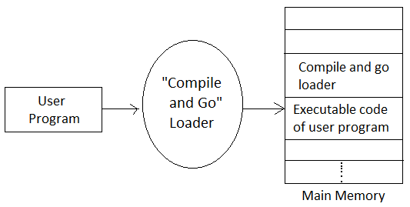
Compile & Go Loader
Advantages: • This scheme is simple to implement. Because assembler is placed at one part of the memory and loader simply loads assembled machine instructions into the memory.

Slide 6
Compile & Go Loader
Disadvantages: • In this scheme some portion of memory is occupied by assembler which is simply a wastage of memory.
• There is no production of .obj file, the source code is directly converted to executable form
• It cannot handle multiple source programs or multiple programs written in different languages.
• For a programmer it is very difficult to make an orderly modulator program.
The execution time will be more in this scheme as every time program is assembled and then executed.

Slide 7
General Loader Scheme
In this loader scheme, the source program is converted to object program by some translator (assembler). The loader accepts these object modules and puts machine instruction and data in an executable form at their assigned memory. The loader occupies some portion of main memory.
Advantages:
• The program need not be retranslated each time while running it.
• There is no wastage of memory, because assembler is not placed in the
memory, instead of it, loader occupies some portion of the memory.
• It is possible to write source program with multiple programs and multiple
languages.

Slide 8
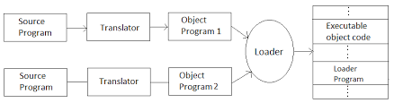
General Loader Scheme

Slide 9
Absolute Loader
Absolute loader is a kind of loader in which relocated object files are created, loader accepts these files and places them at specified locations in the memory.
This type of loader is called absolute because no relocation information is needed; rather it is obtained from the programmer or assembler.
The starting address of every module is known to the programmer.
The programmer should take care of two things
a) Specification of starting address of each module to be used.
b) While branching from one segment to another the absolute
starting address of respective module is to be known by the
programmer.

Slide 10
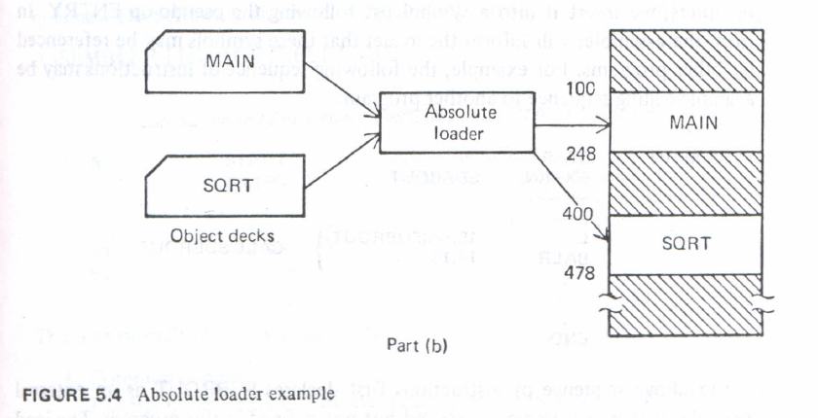
Example of Absolute Loader

Slide 11
Absolute Loader
Thus the absolute loader is simple to implement in this scheme
1) Allocation is done by either programmer or assembler
2) Linking is done by the programmer or assembler
3) Resolution is done by assembler
4) Loading is done by the loader
As the name suggests, no relocation information is needed, if at all it is required then that task can be done by either a programmer or assembler
Advantages: 1. It is simple to implement
2. This scheme allows multiple programs or the source programs written different languages

Slide 12
Absolute Loader
3. The task of loader becomes simpler as it simply obeys the instruction
regarding where to place the object code in the main memory.
4. The process of execution is efficient.
Disadvantages: 1. In this scheme it is the programmer's duty to adjust all the inter segment addresses and manually do the linking activity.
2. If at all any modification is done the some segments, the starting addresses of immediate next segments may get changed,

Slide 13
References
Department of computer Science
Text Books:
Donovan J.J., Systems Programming, New York, Mc-Graw Hill,1972.
Dhamdhere, D.M., Introduction to Systems Software, Tata Mc-Graw Hill1996.
Reference Books:
Aho A.V. and J.D. Ullman Principles of compiler Design Addison Wesley/Narosa

Slide 14

THANK YOU

